Slide 1
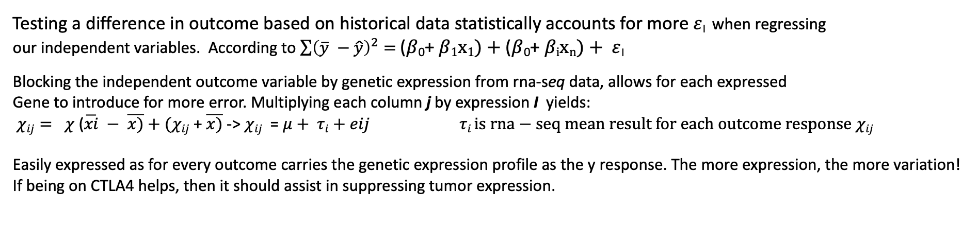
HYPOTHESIS
H0 = There is no difference in outcome response to the inhibitor if previous Ipilumimab treatment was prescribed
HA = The difference in response to the inhibitor is significant between patients prescribed a previous Ipilumimab treatment
Testing a difference in outcome based on historical data statistically accounts for more $ε$_{I} when regressing
our independent variables. According to $\sum{{\left(\overline{y} −\hat{y}\right)}^{2}= }$($β$₀+ $β1x1)+$($β$₀+ $βixn)+ ε$_{I}
Blocking the independent outcome variable by genetic expression from rna-seq data, allows for each expressed
Gene to introduce for more error. Multiplying each column j by expression I yields:
$χij= χ$ ($\overline{xi} − \overline{x)}+(χij$ + $\overline{x)}$ -> $χij$ = $μ+ τi+eij$ $τi is rna−seq mean result for each outcome response$ $χij$
Easily expressed as for every outcome carries the genetic expression profile as the y response. The more expression, the more variation!
If being on CTLA4 helps, then it should assist in suppressing tumor expression.

Slide 2
A Note
Please review the R Markdown for data manipulation, as an explanation was composed there on how this data was created.
I will explain the outcomes based on analysis of finalized data.
SAS and JMP software were also used to great these graphs.

Slide 3
Principle Components Analysis
2-Factor PCA analysis as presented:
Interesting forces at play, a variation in the response
Of the matrix 2-factor rotation. As with the Naive, initial
Observation is clear that Complete Response
is not effected by PC1 And more influenced by
another factor PC2.
However, on CTLA4, antiPD1 treatment super charges
progression through disease state to response state.
Without CTLA4, the variation of the Complete response
is not accounted for by antiPD1 Treatment alone.
With previous treatment, the error is all accounted for
Suggested with its null position on the CTLA4 biplot.
CTLA4:
Naive:

Slide 4
Least Square means comparison
Take a look at the rna-seq LS means associated with each outcome response:
As suggested by the PCA biplot, previous
Treatment does in fact support patients
Progressing through to more promising states in combination with anti-PD1 treatment.
As more error is accounted for by gene tumor suppression, uncertainty turns from high error to increased genetic fit. Minimizing the error of each outcome genetic profile yields a better fit at predicting outcome.

Slide 5
P.Corr
Spearman correlation matrix:
CTLA4 | CR | PD | PR | SD
CR | 1.0000 | -0.3042 | -0.1754 | -0.0497
PD | -0.3042 | 1.0000 | -0.4358 | -0.2936
PR | -0.1754 | -0.4358 | 1.0000 | -0.1427
SD | -0.0497 | -0.2936 | -0.1427 | 1.0000
What about any interaction between the disease state? Do you generally progress by chance or is there an active effect?
Under CTLA4, combinations are strongly inverse Correlated with both treatments administered.
Without CTLA4, weak correlations exist in complete response intervals, meaning unlikely without combination treatment
Niave | mean | CR | PD | PR | SD
mean | 1.0000 | -0.0280 | 0.0013 | -0.0268 | 0.0043
CR | -0.0280 | 1.0000 | -0.3554 | -0.2412 | -0.0979
PD | 0.0013 | -0.3554 | 1.0000 | -0.4714 | -0.1838
PR | -0.0268 | -0.2412 | -0.4714 | 1.0000 | -0.1229
SD | 0.0043 | -0.0979 | -0.1838 | -0.1229 | 1.0000

Slide 6
Heatmap Spearman R²
CTLA4
Niave

Slide 7
Mean response by Outcome Response
In Fact, CTLA4, seems to stabilize the
Progression variation to equal means with
Complete response states.
Rejecting H0, accepting HA.
There is a difference in outcome between
previous Ipilumimab treatment in
combination with anti-PD1 treatment, than
without

Slide 8
So which genes are being suppressed?
Back to the PCA with the factor loadings:
KCNG1 ZNF263 ZNF551 genes associated with
CR response are variant without CTLA4 influence and are outside 95% confidence due the second factor influence. At CTLA4 influence, PR ANXA1 and AAGAB genes and SD ZSCAN4 dominate expression are thrown outside confidence adding error due to their activation
The confidence intervals and regressing CR related genes pull back to null position because the PR and SD genes are activated accounting for the variation.
CTLA4
Naive

